Slide 1
SQL Library Management System By: Michelle Nduku Munyao

Slide 2

About the Project
Built a library database in MySQL.
Demonstrated DDL, DML and SQL Queries.
Showcased skills in filtering , joins , aggregations etc.

Slide 3
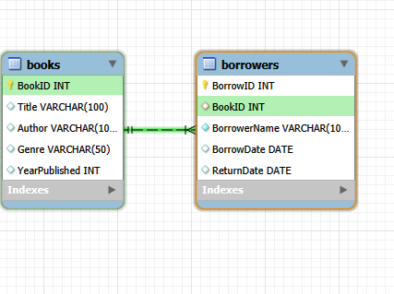
Database Schema

Slide 4
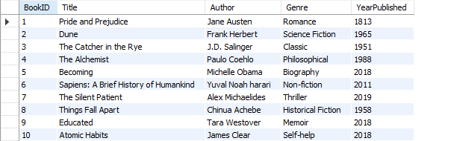
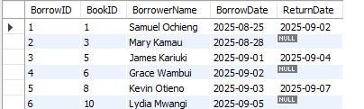
Table: Books
Table: Borrowers

Slide 5
Query 1: View all Books
SELECT * FROM Books;

Slide 6
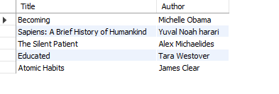
Query 2: Find all books published after 2010
SELECT Title, Author
FROM Books
WHERE YearPublished > 2010;

Slide 7
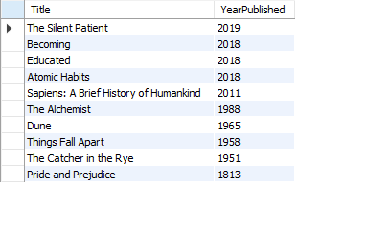
Query 3: List all books ordered by year
SELECT Title, YearPublished
FROM Books
ORDER BY YearPublished DESC;

Slide 8

Query 3: List all books starting with ‘The’
SELECT Title, Author
FROM Books
WHERE Title LIKE 'The%';

Slide 9
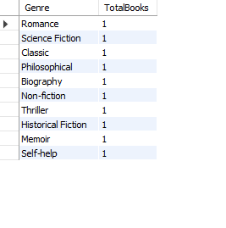
Query 4: Count how many books are in each Genre
SELECT Genre, COUNT(*) AS TotalBooks
FROM Books
GROUP BY Genre;

Slide 10
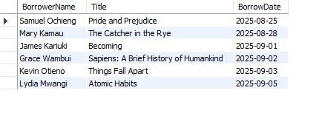
Query 5: List each borrowed book with its borrower
SELECT br.BorrowerName ,b.Title, br.BorrowDate
FROM Books b
INNER JOIN Borrowers br ON b.BookID=br.BookID;

Slide 11
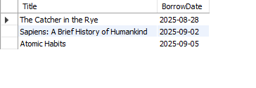
Query 6: Find all Books currently borrowed
SELECT b.Title,br.BorrowDate
FROM Books b
INNER JOIN Borrowers br
ON ReturnDate IS NULL;

Slide 12
Key Findings
Created tables using DDL.
Manipulated using DML.
Wrote queries using filtering , aggregation and joins.
Found books currently borrowed and those not returned.

Slide 13
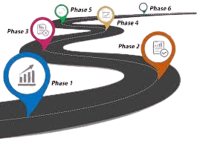
Future Work
Expand Database with more tables(Authors , Staff , etc)
Apply Window functions and CTEs
Connect database to Power BI for dashboards

Slide 14
THANK YOU
Michelle Nduku Munyao

